Slide 1
Lecture 4:
Optimization: Stochastic Gradient Descent and Backpropagation

Slide 2
First “extra session”
This Friday (tomorrow). It is optional.
Topic: Indexing and Broadcasting in Python
How to get rid of loops...
Helpful for first problem set.
Time: 9-10am.
Location CS140.

Slide 3
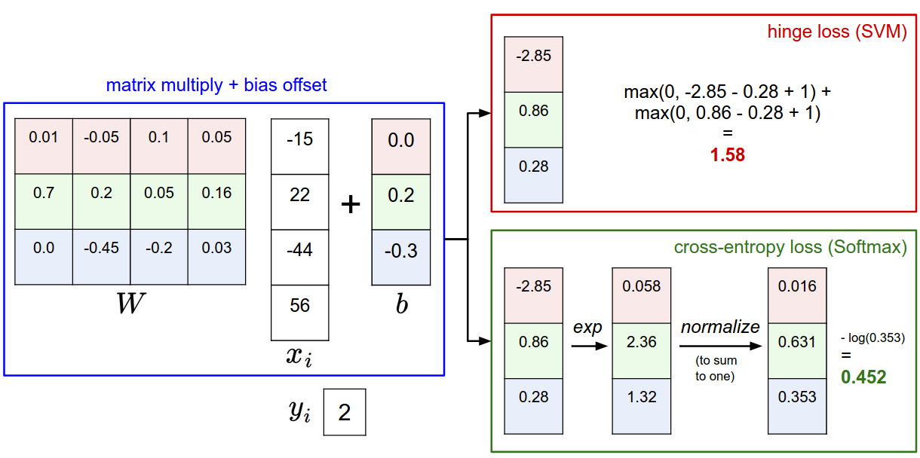

Slide 4
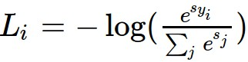

Softmax vs. SVM

Slide 5
Optimization

Slide 6
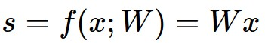
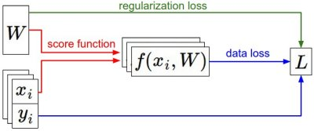
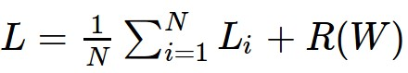
Recap
We have some dataset of (x,y)
We have a score function:
We have a loss function:
e.g.
Softmax
SVM
Full loss

Slide 7
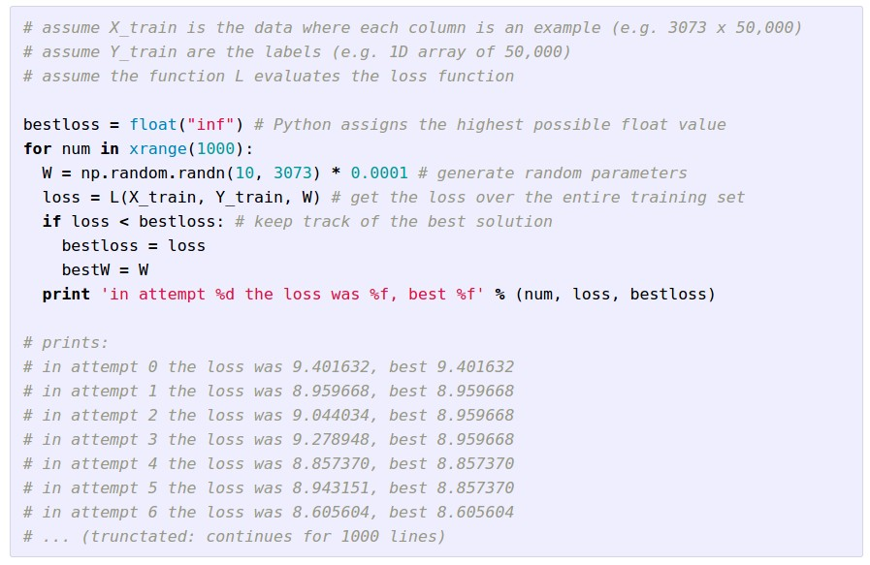
Strategy #1: A first very bad idea solution: Random search

Slide 8
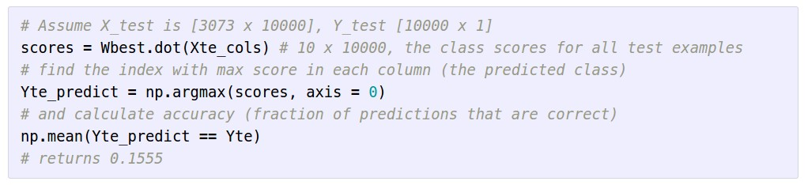
Let’s see how well this works on the test set...
15.5% accuracy! not bad!
(SOTA is ~95%)

Slide 9
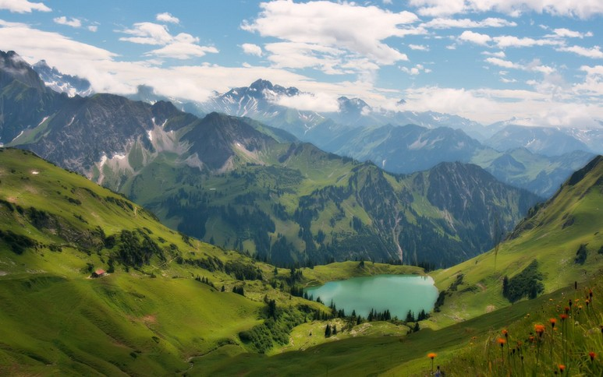

Slide 10


Slide 11
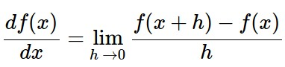
Strategy #2: Follow the slope
In 1-dimension, the derivative of a function:
In multiple dimensions, the gradient is the vector of (partial derivatives).

Slide 12
current W:
[0.34,
-1.11,
0.78,
0.12,
0.55,
2.81,
-3.1,
-1.5,
0.33,…]
loss 1.25347
gradient dW:
[?,
?,
?,
?,
?,
?,
?,
?,
?,…]

Slide 13
current W:
[0.34,
-1.11,
0.78,
0.12,
0.55,
2.81,
-3.1,
-1.5,
0.33,…]
loss 1.25347
W + h (first dim):
[0.34 + 0.0001,
-1.11,
0.78,
0.12,
0.55,
2.81,
-3.1,
-1.5,
0.33,…]
loss 1.25322
gradient dW:
[?,
?,
?,
?,
?,
?,
?,
?,
?,…]

Slide 14
current W:
[0.34,
-1.11,
0.78,
0.12,
0.55,
2.81,
-3.1,
-1.5,
0.33,…]
loss 1.25347
W + h (first dim):
[0.34 + 0.0001,
-1.11,
0.78,
0.12,
0.55,
2.81,
-3.1,
-1.5,
0.33,…]
loss 1.25322
gradient dW:
[-2.5,
?,
?,
?,
?,
?,
?,
?,
?,…]
(1.25322 - 1.25347)/0.0001
= -2.5

Slide 15
current W:
[0.34,
-1.11,
0.78,
0.12,
0.55,
2.81,
-3.1,
-1.5,
0.33,…]
loss 1.25347
W + h (second dim):
[0.34,
-1.11 + 0.0001,
0.78,
0.12,
0.55,
2.81,
-3.1,
-1.5,
0.33,…]
loss 1.25353
gradient dW:
[-2.5,
?,
?,
?,
?,
?,
?,
?,
?,…]

Slide 16
current W:
[0.34,
-1.11,
0.78,
0.12,
0.55,
2.81,
-3.1,
-1.5,
0.33,…]
loss 1.25347
W + h (second dim):
[0.34,
-1.11 + 0.0001,
0.78,
0.12,
0.55,
2.81,
-3.1,
-1.5,
0.33,…]
loss 1.25353
gradient dW:
[-2.5,
0.6,
?,
?,
?,
?,
?,
?,
?,…]
(1.25353 - 1.25347)/0.0001
= 0.6

Slide 17
current W:
[0.34,
-1.11,
0.78,
0.12,
0.55,
2.81,
-3.1,
-1.5,
0.33,…]
loss 1.25347
W + h (third dim):
[0.34,
-1.11,
0.78 + 0.0001,
0.12,
0.55,
2.81,
-3.1,
-1.5,
0.33,…]
loss 1.25347
gradient dW:
[-2.5,
0.6,
?,
?,
?,
?,
?,
?,
?,…]

Slide 18
current W:
[0.34,
-1.11,
0.78,
0.12,
0.55,
2.81,
-3.1,
-1.5,
0.33,…]
loss 1.25347
W + h (third dim):
[0.34,
-1.11,
0.78 + 0.0001,
0.12,
0.55,
2.81,
-3.1,
-1.5,
0.33,…]
loss 1.25347
gradient dW:
[-2.5,
0.6,
0,
?,
?,
?,
?,
?,
?,…]
(1.25347 - 1.25347)/0.0001
= 0

Slide 19
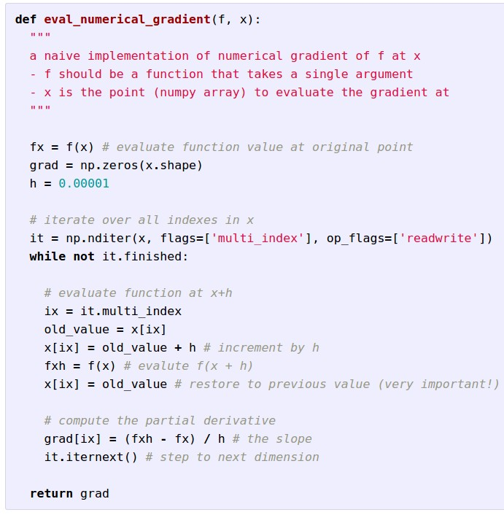
Evaluating the
gradient numerically

Slide 20
Evaluating the
gradient numerically
approximate
very slow to evaluate

Slide 21
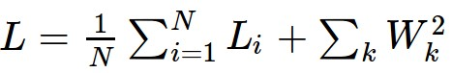
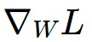
This is silly. The loss is just a function of W:
want

Slide 22
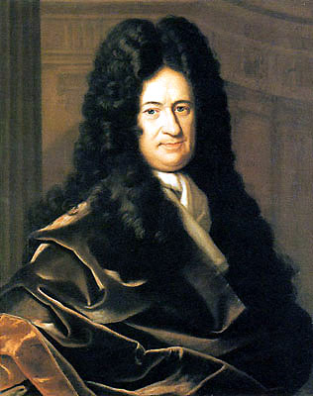
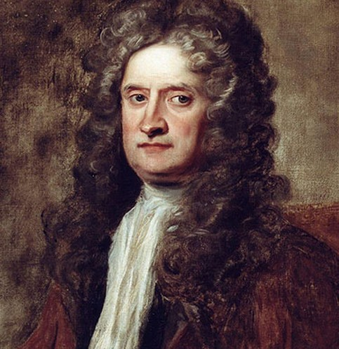
This is silly. The loss is just a function of W:
want

Slide 23

This is silly. The loss is just a function of W:
want
Calculus

Slide 24
This is silly. The loss is just a function of W:
= ...

Slide 25
current W:
[0.34,
-1.11,
0.78,
0.12,
0.55,
2.81,
-3.1,
-1.5,
0.33,…]
loss 1.25347
gradient dW:
[-2.5,
0.6,
0,
0.2,
0.7,
-0.5,
1.1,
1.3,
-2.1,…]
dW = ...
(some function of data and W)

Slide 26
In summary:
Numerical gradient: approximate, slow, easy to write
Analytic gradient: exact, fast, error-prone
=>
In practice: Always use analytic gradient, but check implementation with numerical gradient. This is called a gradient check.

Slide 27
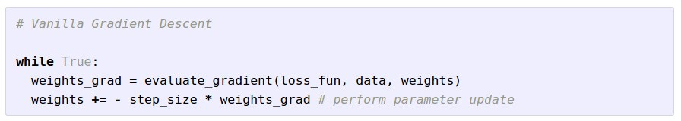
Gradient Descent

Slide 28
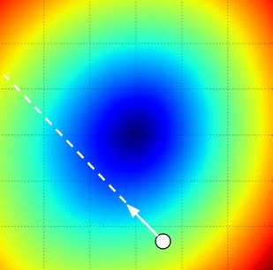
W_2
original W
W_1
negative gradient direction

Slide 29
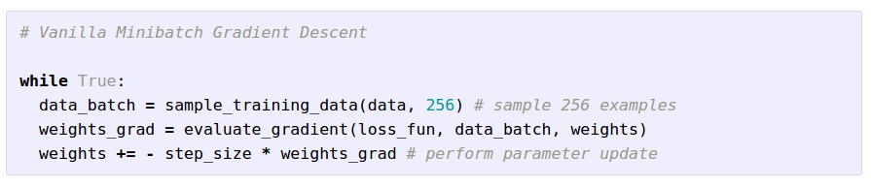
Mini-batch Gradient Descent
only use a small portion of the training set to compute the gradient.
Common mini-batch sizes are 32/64/128 examples
e.g. Krizhevsky ILSVRC ConvNet used 256 examples

Slide 30
Mini-batch Gradient Descent
only use a small portion of the training set to compute the gradient. Why?
Goal is to estimate the gradient
Trade-off between accuracy and computation
No point in doing more computation if it won’t change the updates

Slide 31
Mini-batch Gradient Descent
only use a small portion of the training set to compute the gradient.
Common mini-batch sizes are 32/64/128 examples
e.g. Krizhevsky ILSVRC ConvNet used 256 examples

Slide 32
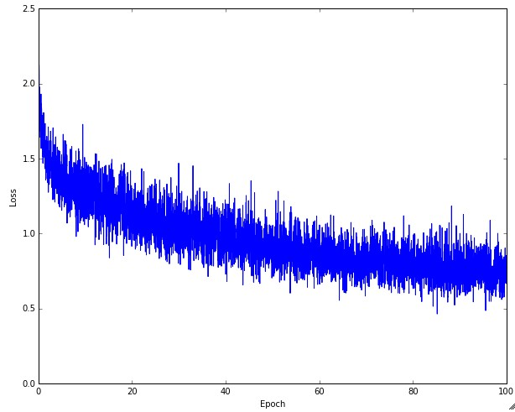
Example of optimization progress while training a neural network.
(Loss over mini-batches goes down over time.)

Slide 33

The effects of step size (or “learning rate”)

Slide 34
Mini-batch Gradient Descent
only use a small portion of the training set to compute the gradient.
we will look at more fancy update formulas
(momentum, Adagrad, RMSProp, Adam, …)
Common mini-batch sizes are 32/64/128 examples
e.g. Krizhevsky ILSVRC ConvNet used 256 examples

Slide 35

The effects of different update form formulas
(image credits to Alec Radford)

Slide 36
Backpropagation
and
Neural Networks part 1

Slide 37
Where we are...
scores function
SVM loss
data loss + regularization
want

Slide 38
Optimization
(image credits
to Alec Radford)

Slide 39
Gradient Descent
Numerical gradient: slow :(, approximate :(, easy to write :)
Analytic gradient: fast :), exact :), error-prone :(
In practice: Derive analytic gradient, check your implementation with numerical gradient

Slide 40
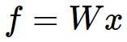
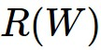
Computational Graph
x
*
s (scores)
hinge loss
+
L
W
R

Slide 41

Convolutional Network
(AlexNet)
input image
weights
loss

Slide 42
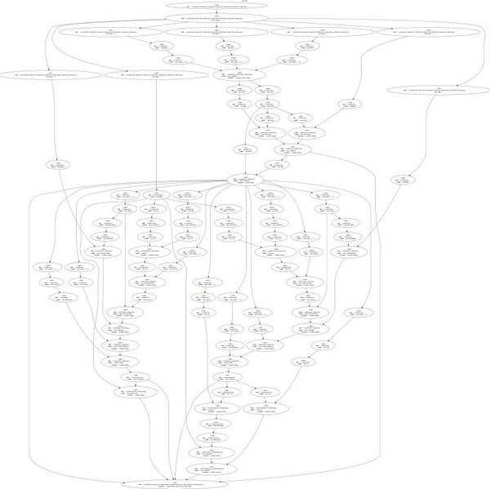
Neural Turing Machine
input tape
loss

Slide 43
Overview of where we’re going
We want to evaluate the gradient of a Loss function L(x,W,...), with respect to the parameters (weights) of a neural network, at the “point” represented by the arguments to the function (x,W,...).
We are not interested in an algebraic expression for the gradient, but rather only in the evaluation of that gradient at the current value of the function arguments.

Slide 44
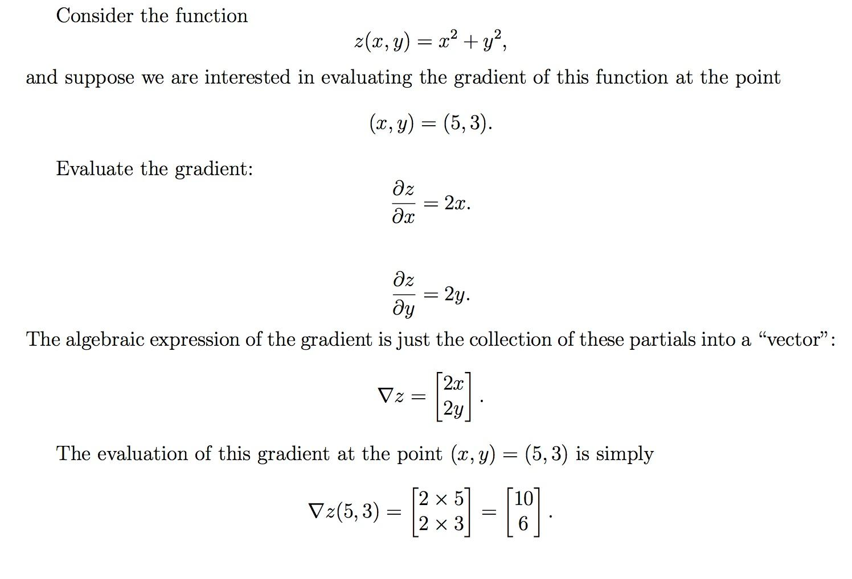

Slide 45
Don’t care about this
Do care about this

Slide 46
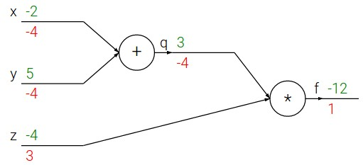
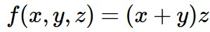
e.g. x = -2, y = 5, z = -4

Slide 47
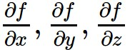
e.g. x = -2, y = 5, z = -4
Want:

Slide 48
e.g. x = -2, y = 5, z = -4
Critical technique! Introduce names (variables) for intermediate results!
Want:

Slide 49
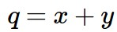
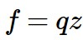
e.g. x = -2, y = 5, z = -4
Critical technique! Introduce names (variables) for intermediate results!
Want:

Slide 50
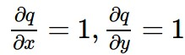
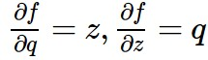
e.g. x = -2, y = 5, z = -4
Critical technique! Introduce names (variables) for intermediate results!
Want:

Slide 51
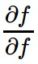
e.g. x = -2, y = 5, z = -4
Want:

Slide 52
e.g. x = -2, y = 5, z = -4
Want:

Slide 53
e.g. x = -2, y = 5, z = -4
Want:

Slide 54
e.g. x = -2, y = 5, z = -4
Want:

Slide 55
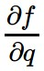
e.g. x = -2, y = 5, z = -4
Want:

Slide 56
e.g. x = -2, y = 5, z = -4
Want:

Slide 57
e.g. x = -2, y = 5, z = -4
Want:

Slide 58
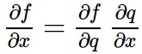
e.g. x = -2, y = 5, z = -4
Chain rule:
Want:

Slide 59
e.g. x = -2, y = 5, z = -4
Want:

Slide 60
e.g. x = -2, y = 5, z = -4
Chain rule:
Want:

